Slide 1


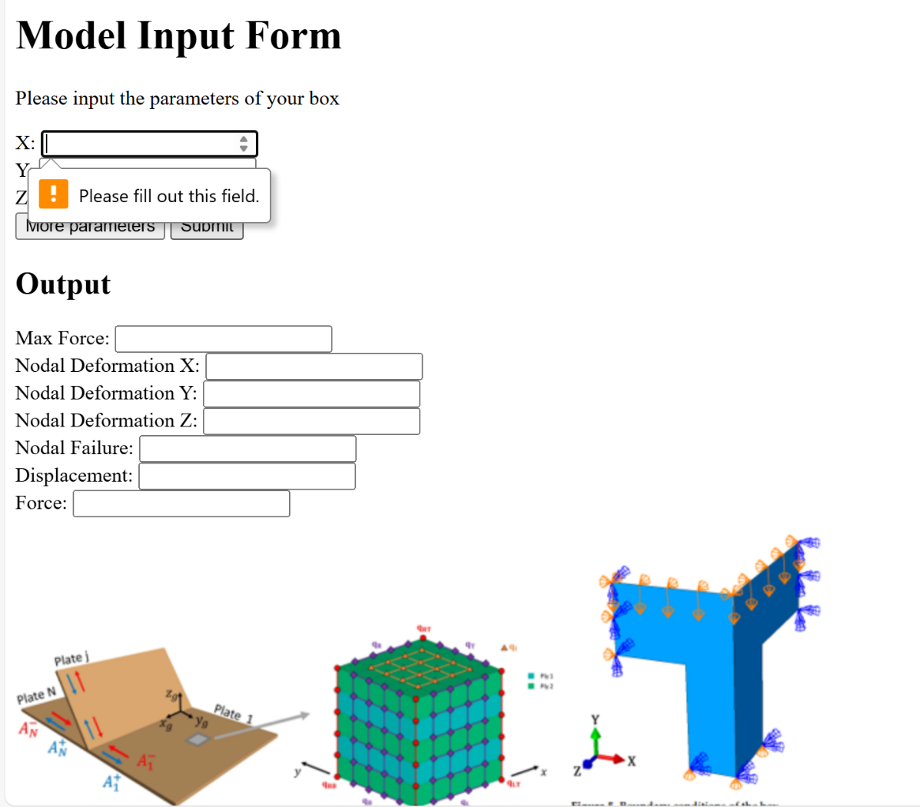
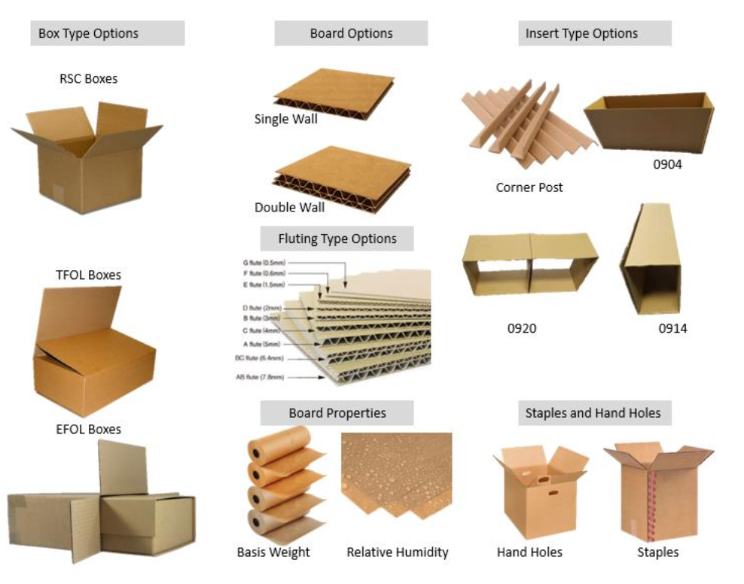
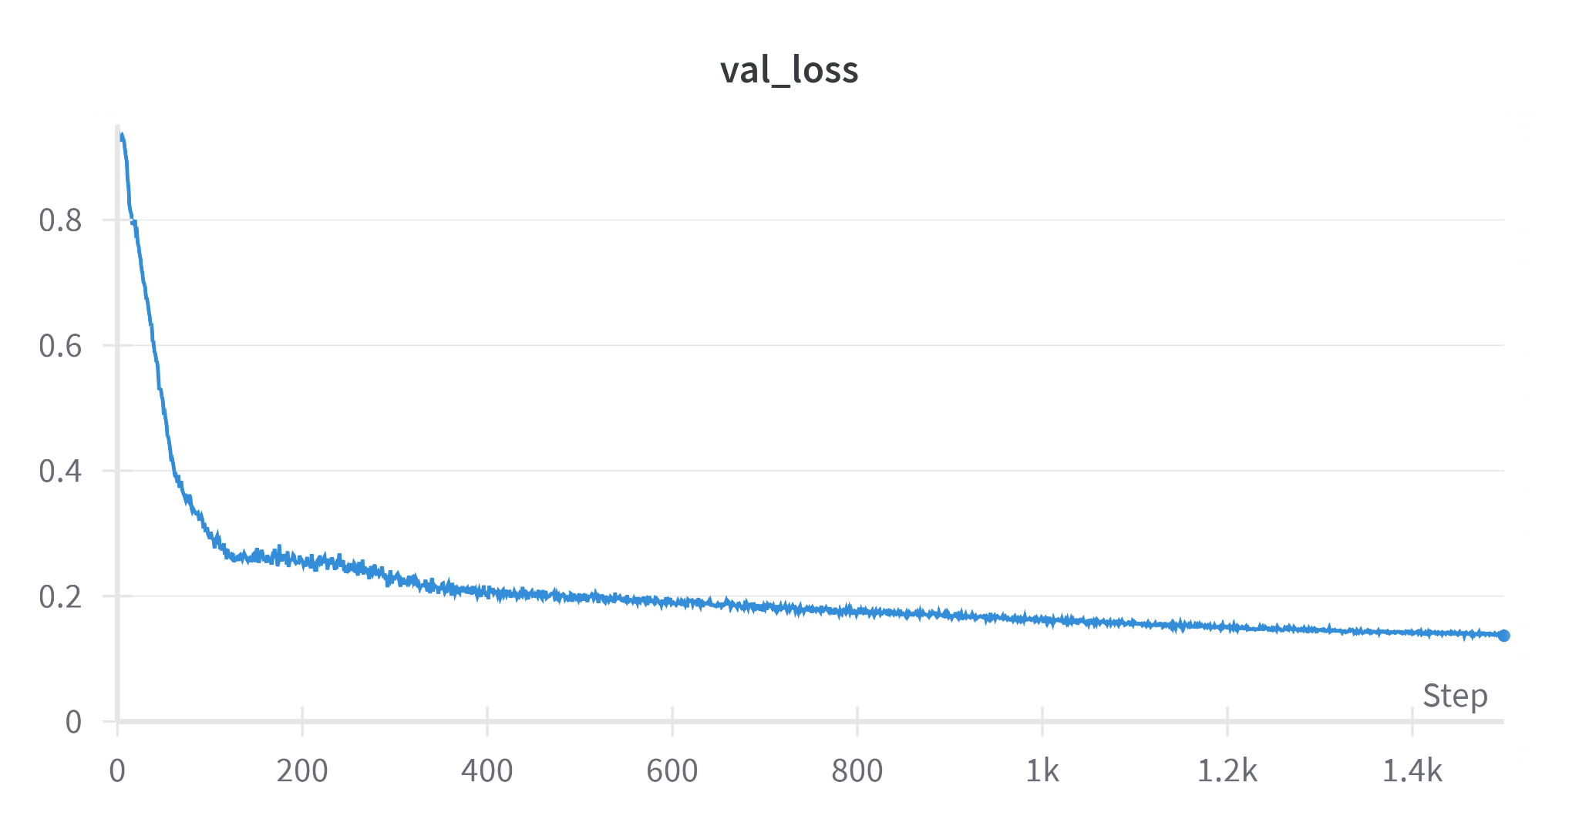
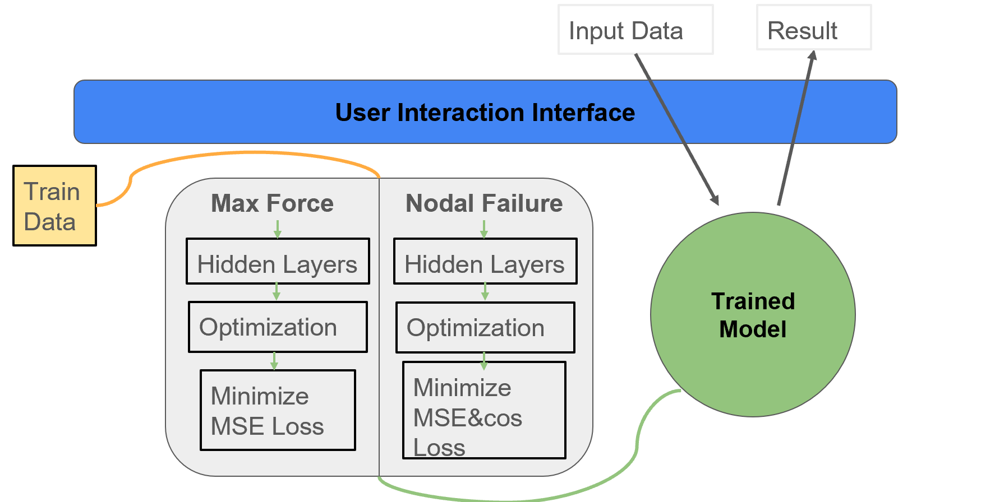
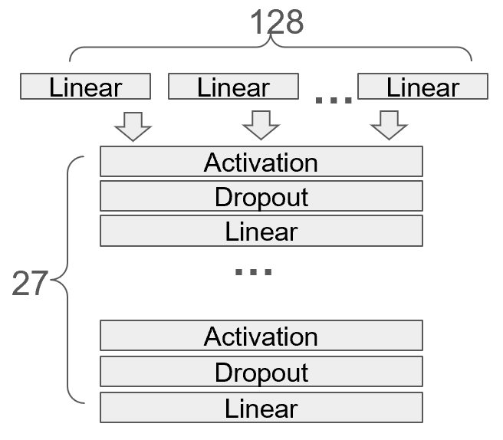
VM450 • Design and Manufacturing III
& VE450 • Major Design Experience
Replacing a cloud based computation tool on DrBoxOnline.com with faster running neural network
Sponsor: Prof. Shane Johnson
Instructor: Prof. Jigang Wu
Team Members: Keye Chen, Yanzhuo Cao, Shuo Deng, Fengyu Zhang, Yukuan Zhu
Problem Statement
Corrugated paper boxes are extensively used in packaging and logistics due to their lightweight, recyclable, and customizable properties. However, these boxes are prone to buckling during storage and shipment, leading to product damage, lost revenue, wasted resources, and customer complaints. The current solution, Dr. Box Calculator Pro, uses Finite Element Analysis (FEA) to predict box performance. While FEA is effective, it is time-consuming and requires significant computational resources. This inefficiency presents a major challenge for industries that need quick and reliable predictions to make timely decisions and optimize operations.
Fig. 1 Different properties of
Corrugated Boxes
Concept Generation
To replace FEA, we explored Decision Boosting Trees, Support Vector Machines (SVM), and Deep Neural Networks (DNN). DNNs were chosen for their ability to handle complex, non-linear data and provide fast, accurate predictions.
Fig. 2 Concept Diagram
Design Description
We designed a DNN model to replace FEA in Dr. Box Calculator Pro. This model leverages GPU acceleration to efficiently handle large-scale data and complex models. It includes multiple layers between the input and output, enabling automatic feature learning and end-to-end processing. Data augmentation, such as spatial symmetry, enhances generalization. Anomaly detection and exception handling ensure robustness. Additionally, a user-friendly front-end interface was developed to improve accessibility, allowing users to input data and receive instant predictions, making the tool practical for real-world applications.
Fig.3 Basic User Interface
Modeling and Analysis
A multilayer ANN with linear layers, ReLU activation, dropout, and batch normalization was developed. The final model, incorporating self-attention modules, improved accuracy while reducing the number of parameters, transforming inputs into precise predictions.
Fig. 4 Model Structure
Validation
Validation Process:
For training and validation loss, the model was trained over 1,400 steps, with the training loss decreasing rapidly and stabilizing, while validation loss maintained a low value, indicating minimal overfitting.
For predictive accuracy and computational cost, simulations were completed within 5 minutes, significantly reducing the need for extensive resources.
Validation Results:
According to the validation, most specifications can be met:
Predictive accuracy: > 90%
Analysis time: ≤ 5 minutes per simulation
Computational cost: Reduced from 600 cores to 1 core
System reliability: > 99.9%
Fig.5 Training Loss
Conclusion
Integrating DNNs into Dr. Box Calculator Pro offers instant predictions, reduces computational costs, and handles diverse box types and conditions. This approach improves accuracy, operational efficiency, and customer satisfaction by minimizing product damage during transit.
Acknowledgement
Sponsor: Shane Johnson, Tanzeelur Rehman from UM-SJTU Joint Institute
Instructor: Jigang Wu from UM-SJTU Joint Institute

